Slide 1
Developing the Whole Student: Community and Service—Service Learning
William Huitt
Christine Ratzke de Figueiredo

Slide 2
Community and Service
Service Learning
Without community service, we would not have a strong quality of life. It's important to the person who serves as well as the recipient. It's the way in which we ourselves grow and develop.
Dr. Dorothy I. Height, president and CEO of the NCNW (National Council of Negro Women)

Slide 3
Community and Service
Service Learning
Active involvement in service activities will undoubtedly generate empathy and respect for others.
Positive actions and contact with other social and cultural environments will without doubt enrich any person emotionally, socially, morally and culturally.

Slide 4
Community and Service
Service Learning
Do it! Feel it!
Active engage allows the individual to discover the deep wish inside one’s self to help others, to be in service for others.
It is one way for an individual to create and generate a meaning and purpose of life overall.

Slide 5
MYP Community and Service
Encourages students to become aware of their roles and responsibilities.
Develop awareness of the complexity of a community.
Students required to become involved with their communities, benefiting the service provider as well as the recipient.
Meaningful reflection is essential to develop positive attitudes, better awareness of needs and quality of response as well as developing consciousness of their own strengths and limitations.

Slide 6
MYP Community and Service
Primary goals:
Social, emotional, and moral development.
Promotion of a local-global citizen

Slide 7
Winter Sports
Service Learning Project
Winter Sports activities organized by and with an Institution for people with intellectual disabilities in consolidation with 18 students from the St. Dominic´s International School/Portugal.
Contact made by C. & S. Coordinator, (could have been done by students) and a decision for combined winter holidays was made.
Financial support for the Institution and their students was necessary.
Creation of a student run “fund raising” Committee. A lot of effort went into this, nevertheless not sufficient money was obtained. A Charity Organization, PTA and a single parent helped with donations.
Initial uneasiness/students out of their comfort zone/soon great involvement with the intellectual disabled. Often teamwork was necessary.

Slide 8
Winter Sports
Service Learning Project
  The following objectives in the area of Interaction for Community and Service were connected to academic areas:
Humanities
Languages
Science
Religious Education
Other

Slide 9
Winter Sports
Service Learning Project
Students experience an adventure in dramatic and inspirational nature based environments; they develop relationship, communication, teamwork and leadership skills.
  MYP /Humanities: Slavery
  Grade 9/ Language: Teenage Relationships/Family-related units/Community-related units.
Improves confidence to overcome new challenges, both by the activity of radical sports as well as by learning to communicate and standing by the side of a Intellectual disabled person.
DP/ Inequalities (Disabled facilities, etc.)

Slide 10
Winter Sports
Service Learning Project
Awareness and understanding of the complexity of a community in its different forms.
Humanities: Unit of Settlement
Science: Environmental balance and human impact on the environment.
Students become aware of specific issues /in this case the diversity of men/their capability of learning, of integrating in the society/their wish to be included in “our world”.
Science: Brain biology – how people are analyzed with different functions of the brain.

Slide 11
Winter Sports
Service Learning Project
A basis for peaceful coexistence and recognition of each person, taking into account its autonomy and individuality.
Humanities: Civil rights; government systems
Languages: Themes such as good life for some/bad life for others; illegal immigration.
Understanding (and acting) of interaction and identification between social minorities and majorities.
Humanities: Integration
Languages: Themes such as good life for some/bad life for others and illegal immigration.
Empathy and respect toward different people and a deeper understanding of the diversity of others.
Humanities: Diversity; race
Science: Species are the same; culturally different, but genetically equal.

Slide 12
Winter Sports
Service Learning Project
As students engage in positive actions and contact with other social environments, a platform is created to enrich students emotionally, socially, morally and culturally.
Languages: Sound mind-body-soul
Science: How you feel about the different environments/Duty to look after different environment/sustainability.
Involvement in the community becomes eventually a state of mind, without looking for any award other then lives enrichment through the insight into different social patterns and ways of life.
Languages: themes such as good life for some/bad life for others and sound mind-body-soul
Religious Education: Tolerance and Understanding.

Slide 13
Winter Sports
Service Learning Project
Students become aware of their own strengths and limitations.
Reinforcement of school´s ethos, vision and values.
Humanities: Political systems
Students and teachers learning and growing together.
Students feel a sense of purpose and place in time and community.
Humanities: In what way does my life differ from my ancestors?

Slide 14
Winter Sports
Service Learning Project
Students have opportunities and the freedom to accept responsibility.
Humanities: Aid vs. Trade
Students learn to care and love, to be mindful, use some of their insight and wisdom.
Students engage in physical activities with individuals of different abilities and skill levels.
Physical Education: skilled participation in different sports.

Slide 15
Winter Sports
Service Learning Project
Issues of Sustainability:
Possibility of a yearly repetition of this event and more involvement during the year through students planned activities such as:
  Football and/or basketball tournament at our school organized by students
  Organizing surfing lessons for the intellectual disabled and participate in their lessons.
  Activities in the woods, like orienteering involving a whole Year group.

Slide 16
Winter Sports
Service Learning Project
Examples of students reflections at the end of the project.
It was really interesting to see that people with this handicap could also have fun and sometimes where even better than us at some sports.
I learned that there is nothing complicated to think of when helping people: If we communicate, not necessarily verbally, but through the “heart” we can understand each other.
In general, it was the biggest challenge in my life ever because I had never done this kind of activity before. It was actually the first time that I needed to sincerely understand people´s minds to help them. Also, I felt that intellectual disabled people are not different at all from us; they just lack on a few aspects, which do not really matter in living in this world.

Slide 17
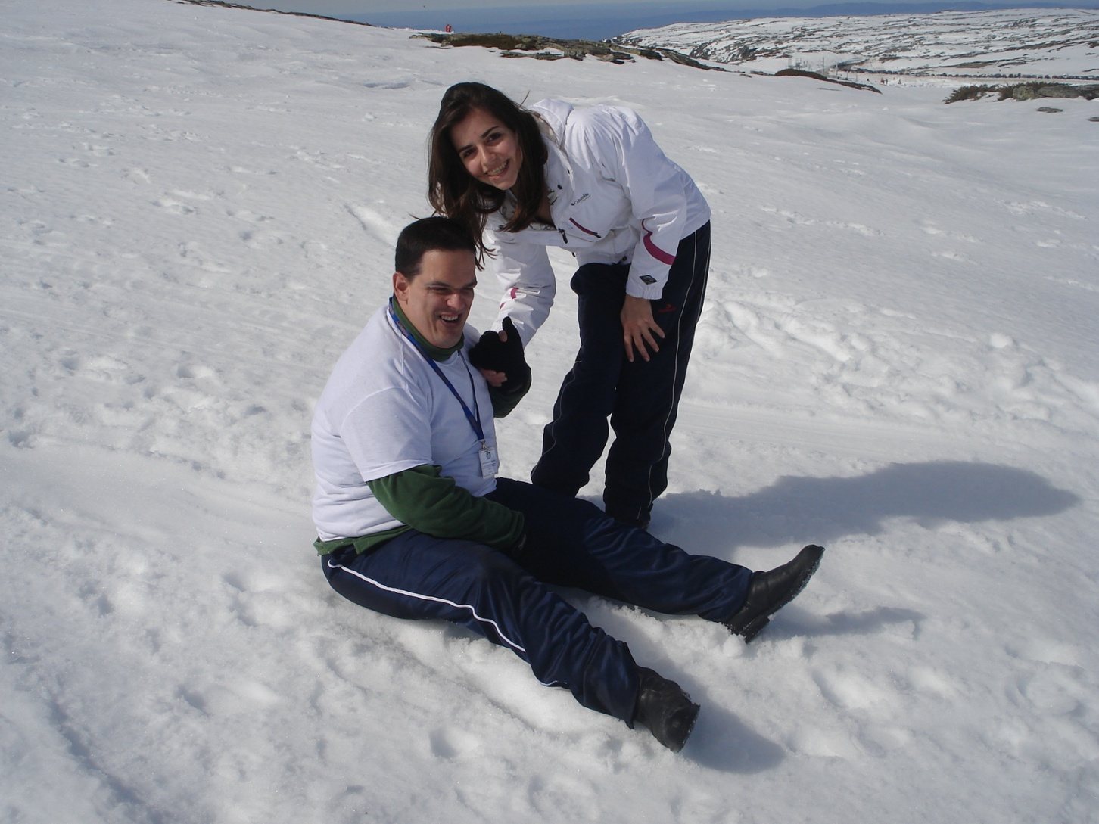
Winter Sports
Service Learning Project

Slide 18
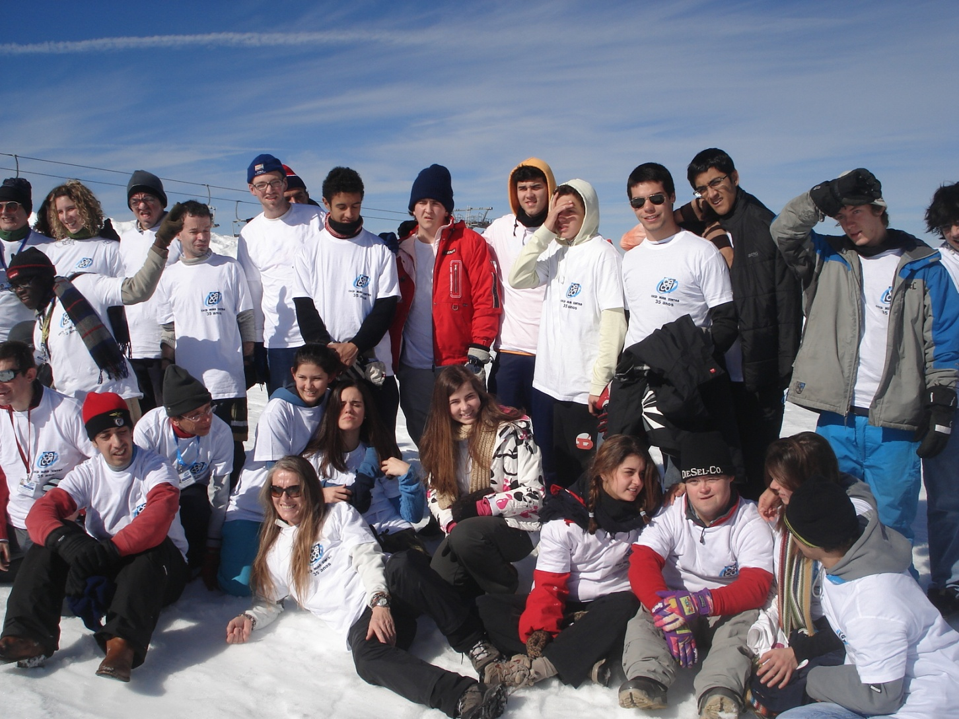
Winter Sports
Service Learning Project

Slide 19
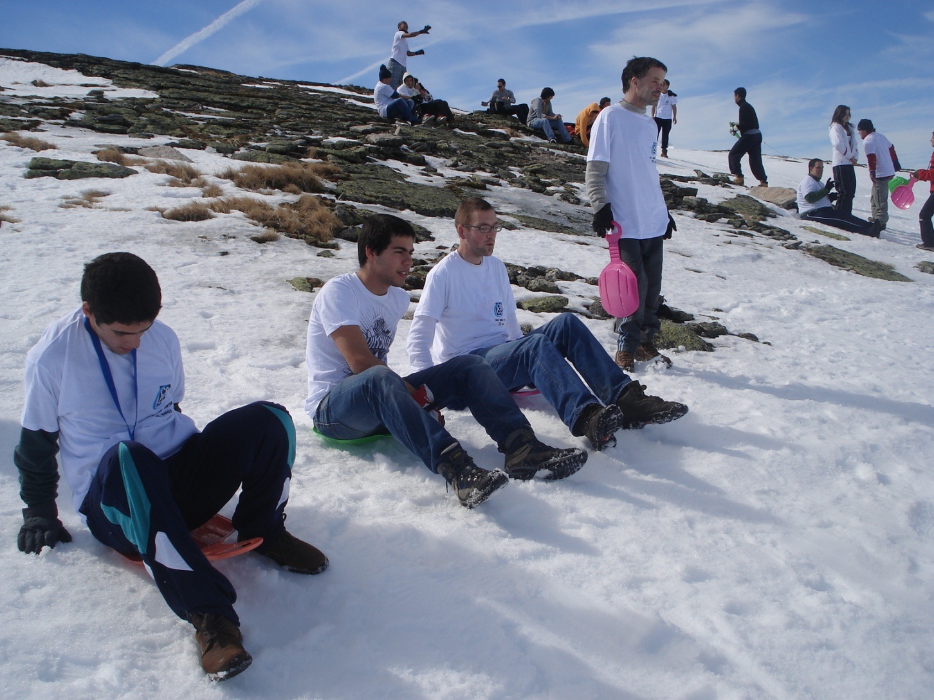
Winter Sports
Service Learning Project

Slide 20
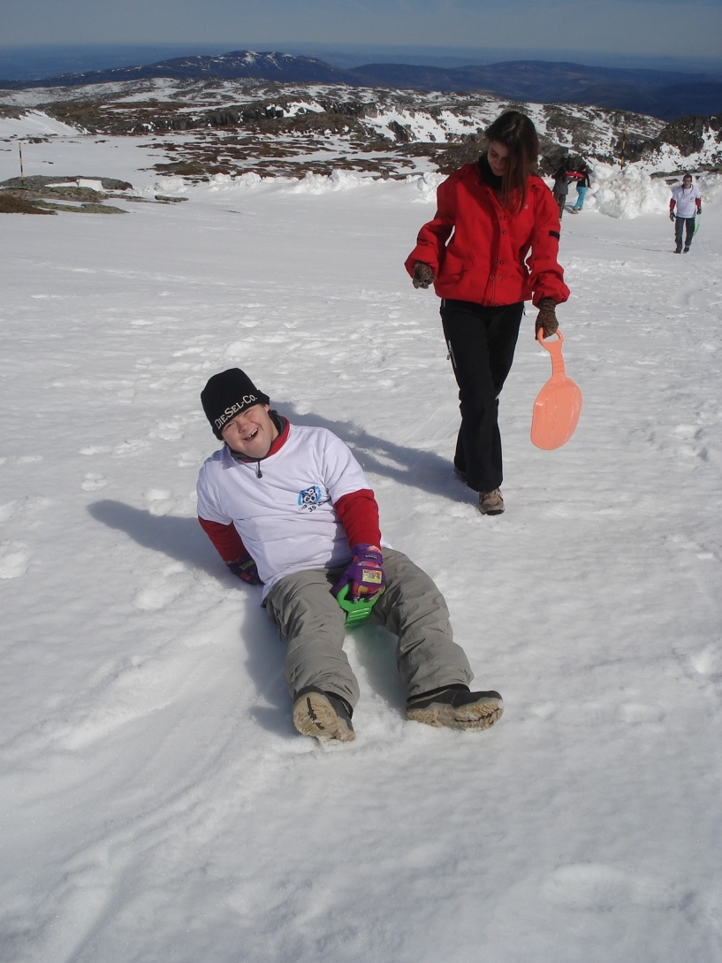
Winter Sports
Service Learning Project

Slide 21
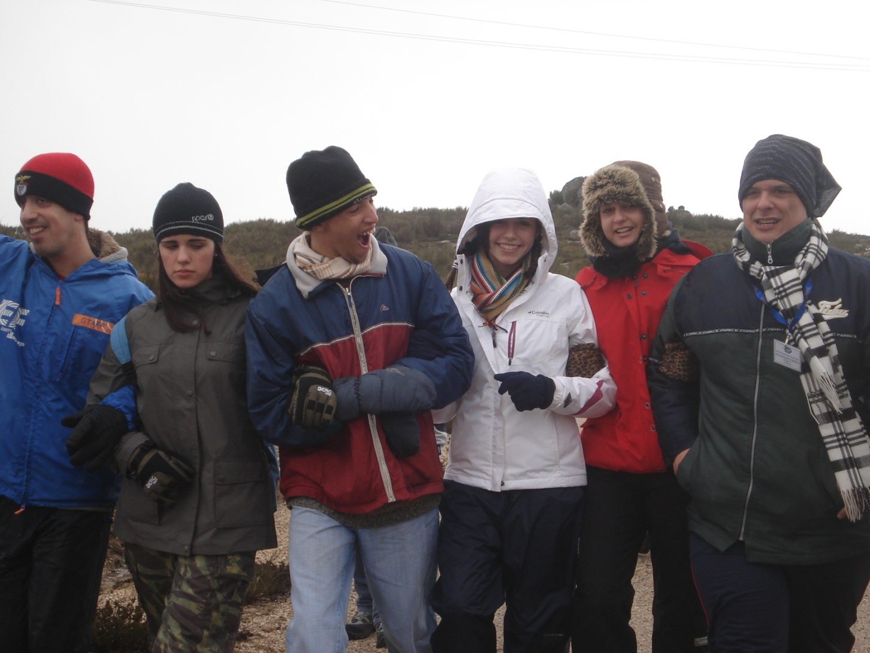
Winter Sports
Service Learning Project

Slide 22
Co Community mmunity
Community and Service
Service Learning
Too often we under-estimate the power of a touch, a smile, a kind word, a listening ear, an honest complement, or the smallest act of caring, all of which have the potential to turn a life around.
Dr. Felice Leonardo Buscaglia

